Slide 1
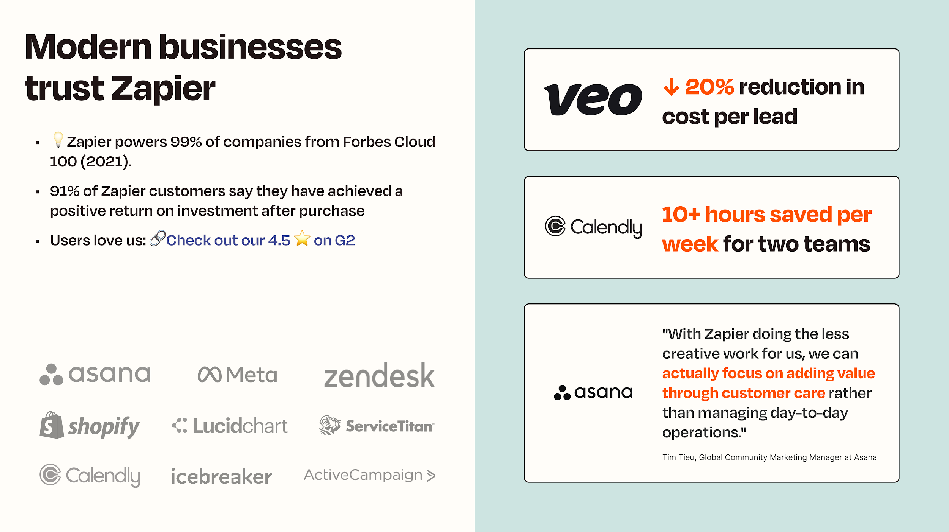
Modern businesses trust Zapier
Notes:
Zapier a crucial part of tech stacks at organizations large and small.
View our customer stories:
[Calendly] How automation makes it easy for Calendly to save time while still providing a top-notch customer experience
[Asana] The art of getting stuff done: How Asana powers its Ambassador program with Zapier
[Veo] How Veo increases sales and lowers lead costs with automation

Slide 2

Customer Stories

Slide 3









CUSTOMER SUCCESS STORY
%
30
reduction in time spent on quality assurance
Customer support
Data management
SaaS (B2B)
%
Before
48
growth enabled by automation
Valuable hours spent collecting and entering customer data.
Manual data entry causing missed data in key strategic reports and analyses.
After
Automated workflows, increasing efficiencies and enabling a 48% increase in team growth.
"Instead of spending hours and hours engineering a Salesforce sync to pull reports manually, we're able to automate this and spend more time on highly strategic initiatives."
Micaela Wright, Associate Digital Marketing Manager at Lucidchart
🔗 Read the full customer story →

Slide 4






CUSTOMER SUCCESS STORY
%
75
More efficient customer onboarding
Customer onboarding
Inventory management
E-Commerce
Before
No capacity to onboard new wholesale customers, resulting in lost revenue
Manual inventory management was prone to errors.
Incorrect shipments and unhappy customers because they couldn't track order changes.
After
"Because of Zapier, all of the account managers are able to focus their time on key accounts and the channel strategy that drives revenue growth."
Revenue growth, fueled by automation, enabled them to grow by 4X in 3 years
Document management, and order processing is automated. Fellow now only spends 8-10 hours a week onboarding.
Streamlined order updates and comms between eCommerce platform and fulfillment, resulting in happier customers (and employees).
— Alicia Roberts, Key Account Sales Manager at Fellow
🔗 Read the full customer story →

Slide 5




CUSTOMER SUCCESS STORY
%
85
product adoption in the first 30 days
Customer onboarding
Data management
Company size: Enterprise
SaaS (B2B)
%
Before
440
increase in onboarding attendance
Average churn rate within the first 90 days as high as 25%.
After
New users are auto-enrolled in the onboarding program.
Churn rate within the first 90 days dropped from 25% to 10%, even reaching as low as 6% some months.
Product adoption within new users' first 30 days doubled.
2x
product adoption in the first 30 days
🔗 Read the full customer story →

Slide 6
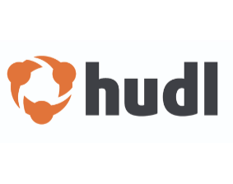






CUSTOMER SUCCESS STORY
%
21.5
decrease in support ticket response time
Customer support
Data management
Enterprise (2800)
Consumer Technology
$15K
Saved in additional software seats
Before
Support requests manually transferred between team members on a variety of software tools.
Customers waiting days for responses causing frustration and lost customers
Many opportunities for support tickets to be missed, lost, or poorly communicated.
10K
tasks automated in two months
After
10,000+ manual tasks removed from the support team's day-to-day work in just two months.
Teams can work with the apps they already use, saving up to $15,000 in Salesforce seats.
Customers receiving responses within hours instead of days.
“Our users get answers and fixes to their issues much faster now. I was also able to leverage Slack and our automations to avoid the need to add dozens of Salesforce licenses for our specialized teams.”
Tori Phillips, Revenue Operations Systems Administrator at Hudl
🔗 Read the full customer story →

Slide 7



CUSTOMER SUCCESS STORY
2
employees worth of time saved with one process (@50K/year salary, $100K savings)
Community management
Customer support
Company size: Enterprise
SaaS (B2B)
Before
To roll out the ambassador program, Asana would need to manually onboard every person
Paired with the existing maintenance work, this made the program unscalable
After
Onboarding to the Ambassador program is handled with automation
Certifications and milestones don’t need human intervention
"Automation has definitely let us scale, and it'll help us continue to scale in the future."
Tim Tieu, Global Customer Marketing Manager at Asana
🔗 Read the full customer story →

Slide 8






CUSTOMER SUCCESS STORY
%
92
faster onboarding experience
HR onboarding
Sales pipeline
Company size: Enterprise
Consumer Technology
10X
Increase in the number of drivers onboarded per day
Before
Growth was fueled by high-touch onboarding
But onboarding new drivers wasn't scaleable. It took 2-3 hours per driver, and had over 10 manual steps
100K+
hours saved
After
Completely automated onboarding (that's 92% faster)
New applicants are added to Airtable, and are moved through the process as they complete tasks
"It's hard to quantify" how much time and money Zapier has saved the team. It's countless, countless hours of manual time. Like, hundreds, thousands, of hours over the lifetime of our business. We've saved at least 10s of thousands of manual hours."
Kenan Saleh, Co-Founder of Halo Cars and GM at Lyft Media
🔗 Read the full customer story →

Slide 9





CUSTOMER SUCCESS STORY
29
step onboarding process automated
Customer support
HR onboarding
Advertising
30
Before
minutes faster responses to support ticket
Customers were waiting too long for a response on their support ticket
The HR onboarding process was manual and time-consuming
After
New support tickets trigger ChatGPT to summarize the request and draft suggested answers, storing them in a private note within the ticket.
When a new employee signs their handbook, a 29-step Zap is triggered, handling the entire onboarding process
“Zapier is integrated into almost every aspect of my company in some way, shape, or form.”
Dan Dorato-Hankins, Chief Technology Officer at Vector Media
🔗 Read the full customer story →

Slide 10





CUSTOMER SUCCESS STORY
%
20
reduction in cost per lead
Lead management
Advertising list management
Company size: Mid-market
Consumer Technology
5x
Before
the number of email journeys
Valuable hours spent downloading lead list and enrolling in email campaigns.
Difficult to identify high quality leads—making it challenging to prioritize them.
Not enough resources to customize purchasing journeys.
After
Leads created in Salesforce, automatically.
Key details extracted from emails and shared with team.
"[Zapier has] helped us accelerate our sales cycle like crazy — and saved us thousands of hours, and costs, because we didn't have to hire a developer to make multiple systems talk to each other."
Over 50 custom purchasing journeys, increasing conversion rates.
—Lars Christensen, Social Ads Specialist at Veo
🔗 Read the full customer story on Entrepreneur.com →

Slide 11



CUSTOMER SUCCESS STORY
4+
hours saved per week by each Product and Support Teams
Lead management
Customer support
Company size: Mid-market
SaaS (B2B)
Before
Increased sales conversions
Revenue generating leads lost in a sea of customer support tickets.
Customer feedback siloed—causing mistakes and a poor customer experience.
Support reps splitting focus between sharing info and helping customers.
After
Leads are created from Zendesk tickets—so sales can follow up while they're hot.
Product gets a constant flow of feedback in Airtable.
Support saves time aggregating feedback to share, and nothing falls through the cracks.
"[With automation] support now has an ongoing feedback loop with the product team. They convey customer information from the frontlines, which improves the product and provides satisfaction to our customers."
—Kate Riney, Brand Storyteller at Calendly
🔗 Read the full customer story →

Slide 12





CUSTOMER SUCCESS STORY
Lead management
Advertising list management
Company size: Enterprise
SaaS (B2B)
Before
Inefficient and inaccurate data entry—causing delays in client comms and a negative customer experience.
Inaccurate marketing lists caused by manual uploading.
“We can feel confident that our remarketing lists remain as fresh as our data."
— Matt Grebow, Senior Manager of Demand Generation
After
Lower operational cost. They gained back time to focus on strategic initiatives that drive revenue, like optimizing their marketing mix
Better attribution, because the team has error-free data to support customers and help them be successful.
Better performing ad mixes because audience profiles are synced across Marketo, Salesforce, and Google Ads.

Slide 13





CUSTOMER SUCCESS STORY
3+
Hours per week saved by one Zap
Customer support
Lead Management
Company size: Mid-market
Consumer Technology
Before
Inconsistent customer profiles across different apps.
Inaccurate lead data made it impossible to send targeted emails or pass qualified leads to the sales team in a timely manner.
No cross-functional visibility due to siloed tech stack.
After
"Since we started using Zapier, so many of our processes have become more efficient and have allowed us to have more time executing and less time compiling data and insights."
Enriched data from multiple sources to provide a personalized customer experience.
Cross-functional visibility to customer data, enabling teams to deliver top-notch customer service.
By automating lead data entry and updates, Orchard saves more than three hours a week.
Corey Egan, Director of CRM at Orchard
🔗 Read the full customer story →

Slide 14



CUSTOMER SUCCESS STORY
10x
growth achieved through streamlined processes.
Onboarding
Company size: Mid-market
Ridesharing
Before
70%
reduction in acquisition costs
Onboarding drivers was a bottleneck: document updates took 5 days, delaying new driver activations.
Operational inefficiencies limited the ability to scale driver acquisitions effectively.
After
Built a Salesforce-integrated onboarding system using no-code tools.
Reduced document update times to under 2 hours, enabling same-day driver activations.
Scaled operations to onboard 25,000+ drivers in 18 months, cutting onboarding time by 50%.
Driver document update time reduced from 5 days to 2 hours.

Slide 15


CUSTOMER SUCCESS STORY
$1M
annual savings through efficiency gains
Onboarding
Company size: Enterprise
Real Estate
Before
Onboarding for real estate agents was inconsistent and inefficient across the country.
Lack of scalable systems hindered alignment between local innovation and national operations.
After
60%
reduction in agent ramp up time
Designed a nationwide onboarding program for 15,000+ agents using Zapier and Airtable.
Established the first systems team to standardize workflows and automations, supporting 150 Agent Experience Managers nationally.
Created scalable solutions to align local and national operations with Compass’s rapid growth.

Slide 16
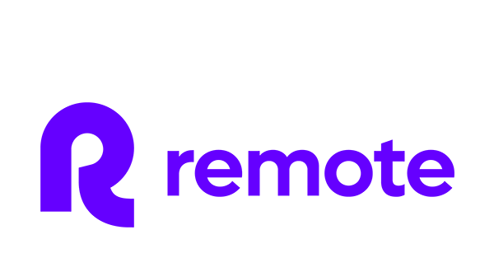



CUSTOMER SUCCESS STORY
28
%
of tickets are now solved automatically
AI-Powered IT Helpdesk
Company size: Enterprise
SaaS (B2B)
1700
Before
employees at Remote
Three-person IT team drowning in 1,000+ monthly tickets as company headcount increased to 1,700.
Overwhelmed IT meant delayed support and burnout risk amid rapid growth.
After
AI-powered IT helpdesk center automates ticket routing and resolution through Okta and knowledge base integration.
“Through our custom IT helpdesk built all on Zapier, our 3 person IT team performs like a team of 10.”
28% of tickets submitted are resolved in minutes with automation, saving time and money.
— Marcus Saito, Head of IT and AI Automation
Notes:
Focused on the IT Helpdesk

Slide 17


CUSTOMER SUCCESS STORY
%
99
reduction in time to build
an integration
Company size: Mid-market
SaaS (B2B)
Before
100s
Creating one single third-party integration took two to three months of development and tens of thousands of dollars in resources.
of hours and thousands of dollars saved annually
When a coded integration needs tweaking, it requires developer hours—which can take months to become available.
After
Third-party integrations can be built within minutes or hours, allowing them to fulfill more customer requests.
"With Zapier, we are able to create, test, and deploy many of the third-party systems integrations required by our customers in less than an hour, without requiring code, developers, software updates, or releases."
Within five minutes, the Brightspot team can make a change to a customer's integration that would've previously taken months.
With the Enterprise plan, Brightspot can assign varying levels of access to team members and segment customer data to keep each one separate.
— James Clark, VP of Platform Product Development at Brightspot
🔗 Read the full customer story →
Notes:
Focused on the IT Helpdesk

Slide 18


CUSTOMER SUCCESS STORY
5-10
minutes saved per support ticket escalation
Customer support
Company size: Enterprise
SaaS (B2B)
850k
Before
tasks and growing
automated in 12 months
SupportOps relied on developers for automation needs, but demand always exceeded bandwidth.
Escalating a support case required logging into Salesforce and multiple steps varying by the type of case.
After
“The most important thing to my team is that we can do a lot of advanced things with Zapier and it’s very easy to accomplish. I can get someone who’s only been here for a few weeks to set up an automation in Zapier. I don’t need a highly technical team—I just need the right tools.”
Centralized, scaleable, and flexible automation solution rolled into a single, Ops-owned Zapier instance.
A CSM submits a case number in Slack, triggering an automated workflow that verifies escalation status across Salesforce, and escalates it if needed per Okta’s policies.
— Korey Marciniak, Senior Manager of Customer Support Strategy and Operations
🔗 Read the full customer story →

Slide 19
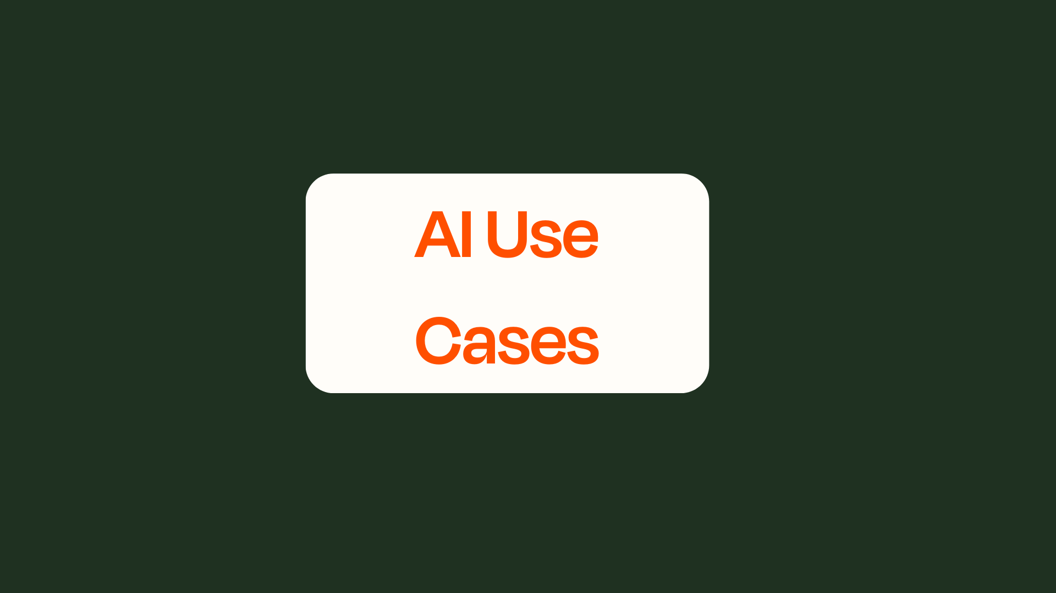

Slide 20
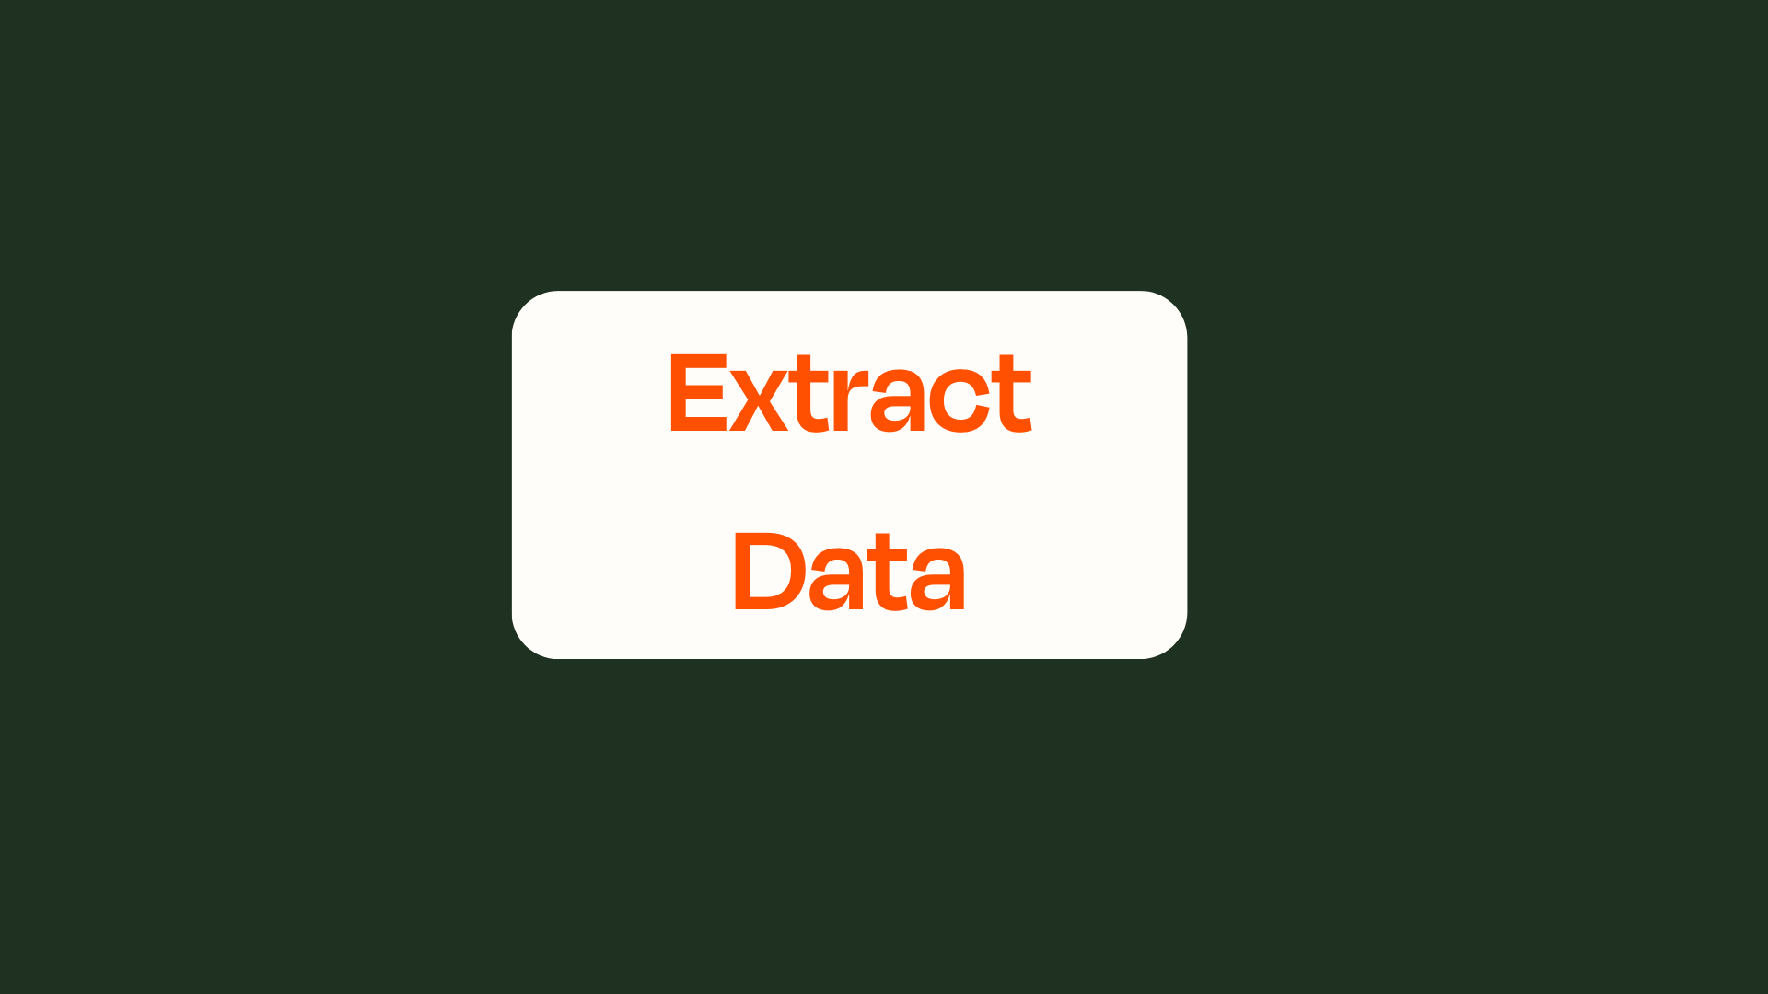

Slide 21
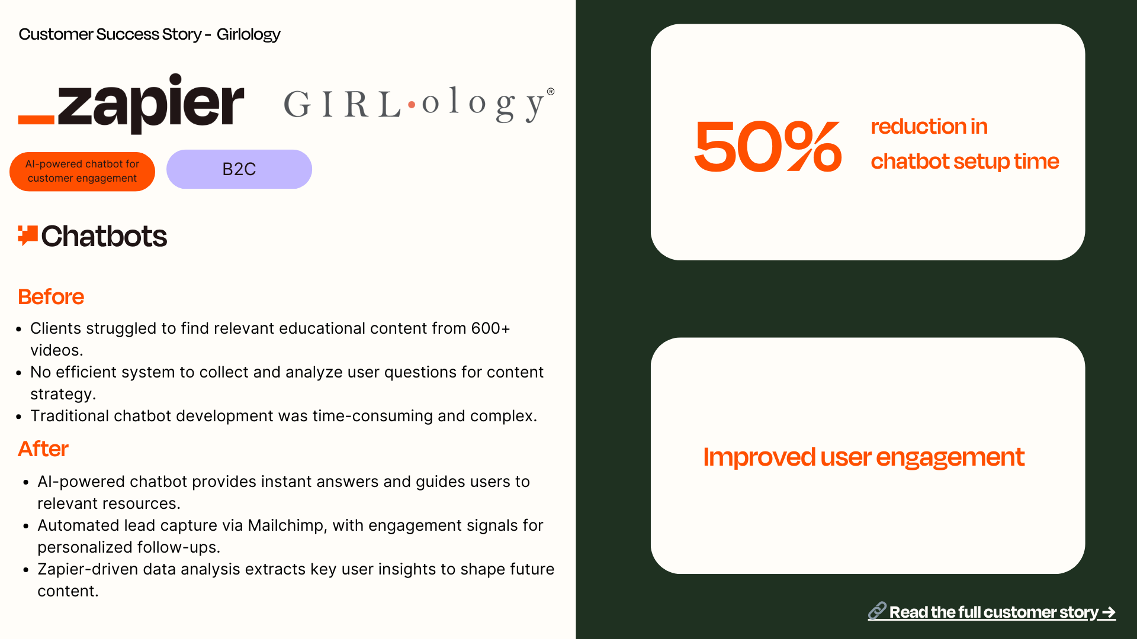

Slide 22
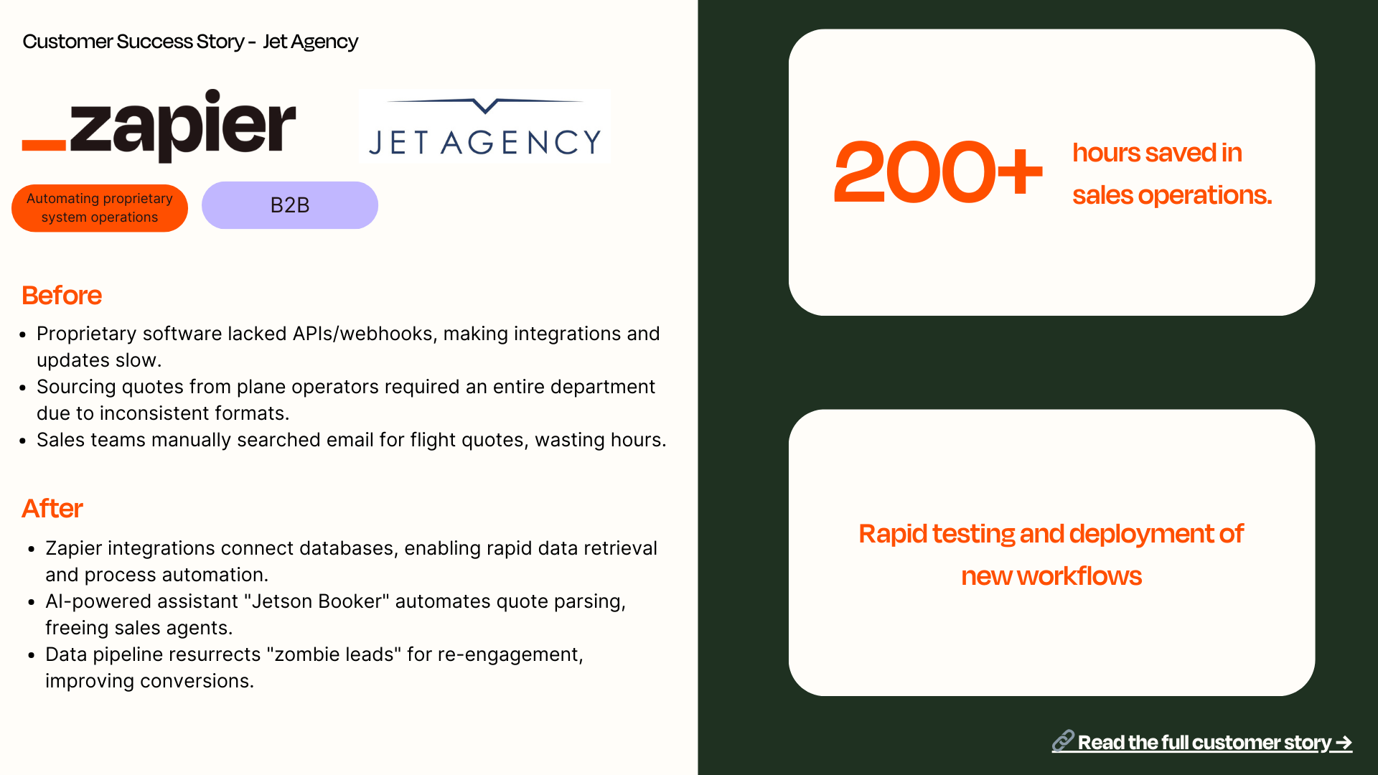

Slide 23
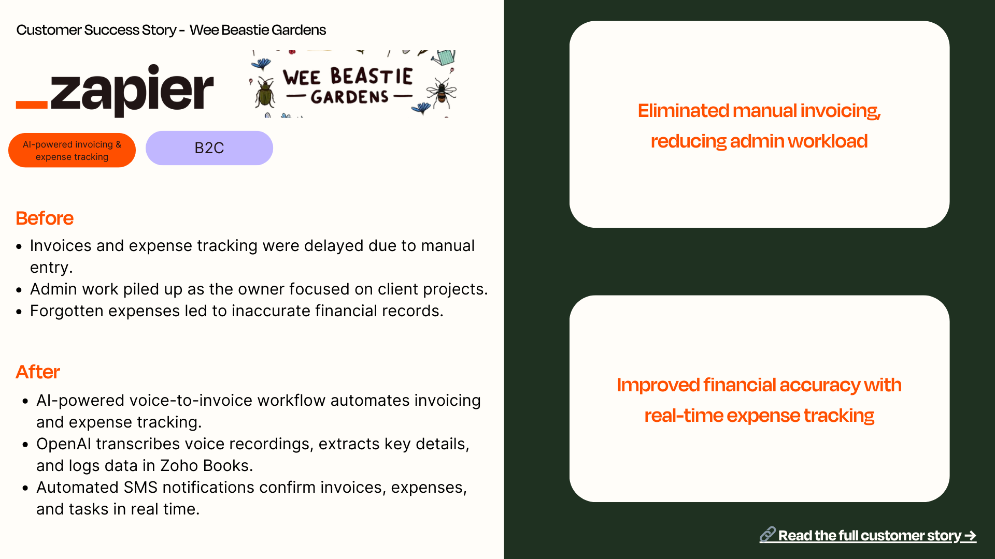

Slide 24
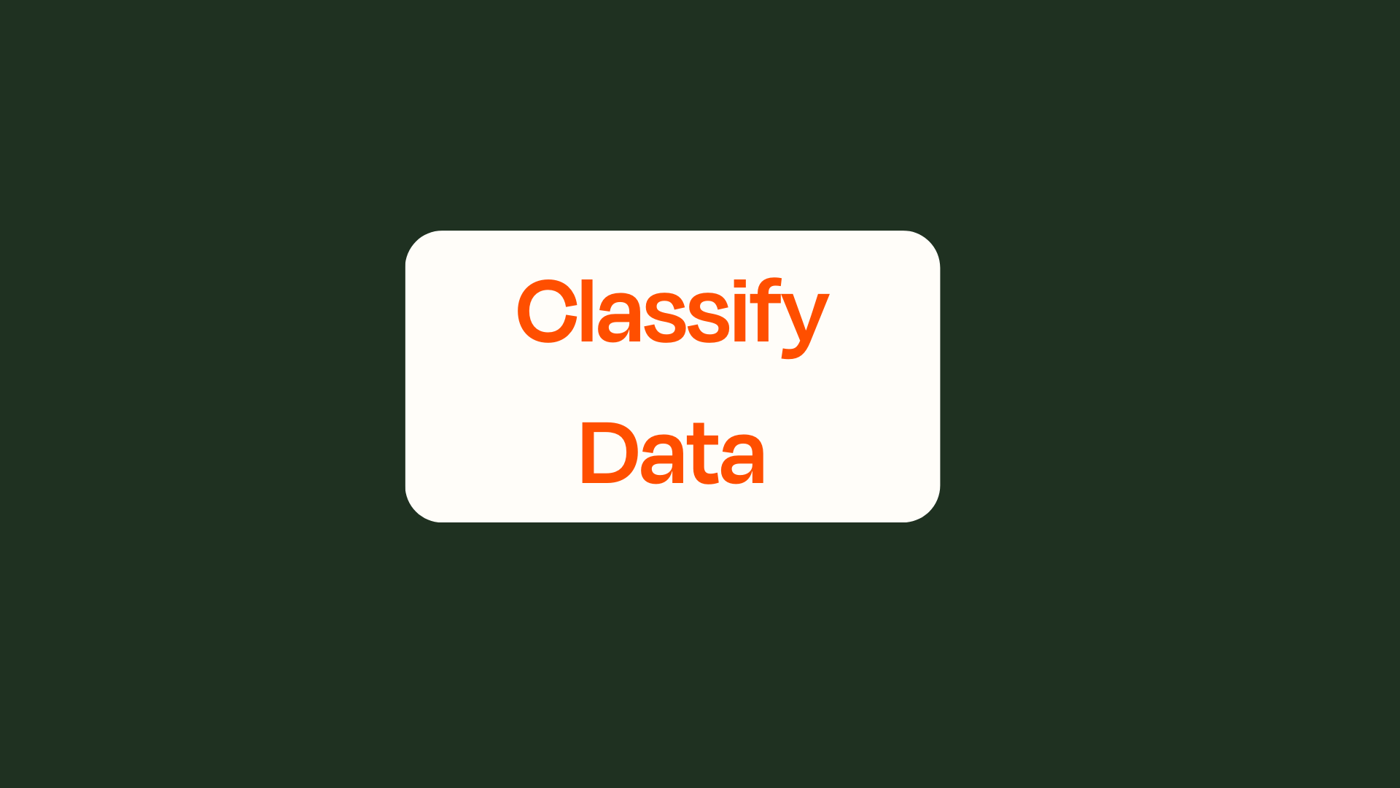

Slide 25
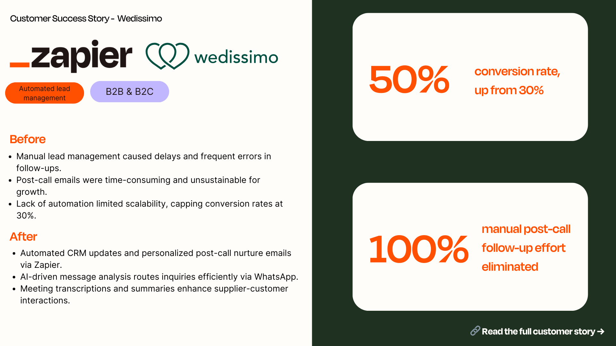

Slide 26
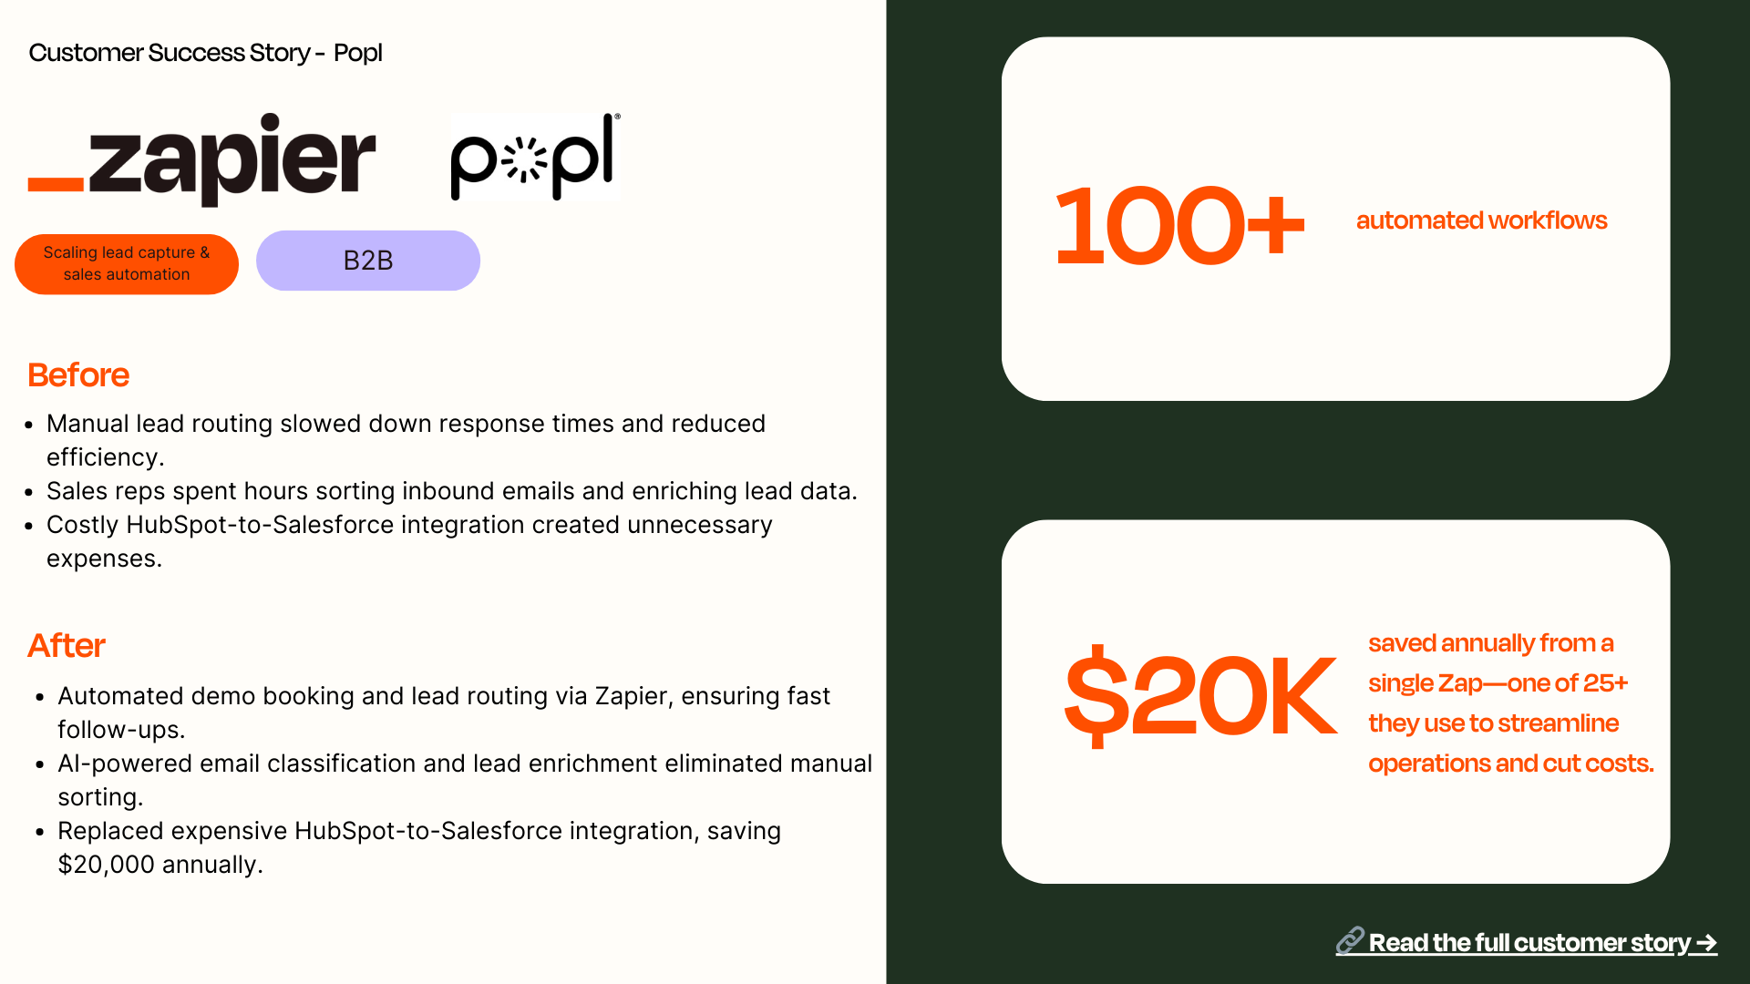

Slide 27
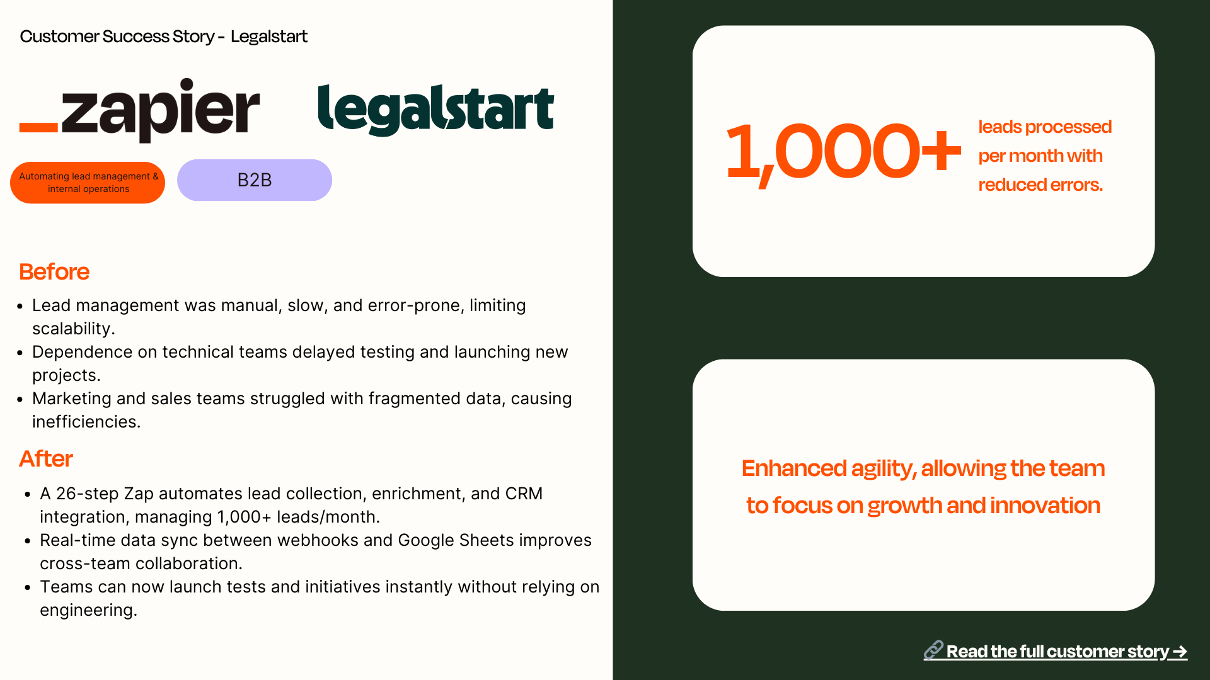

Slide 28


Slide 29
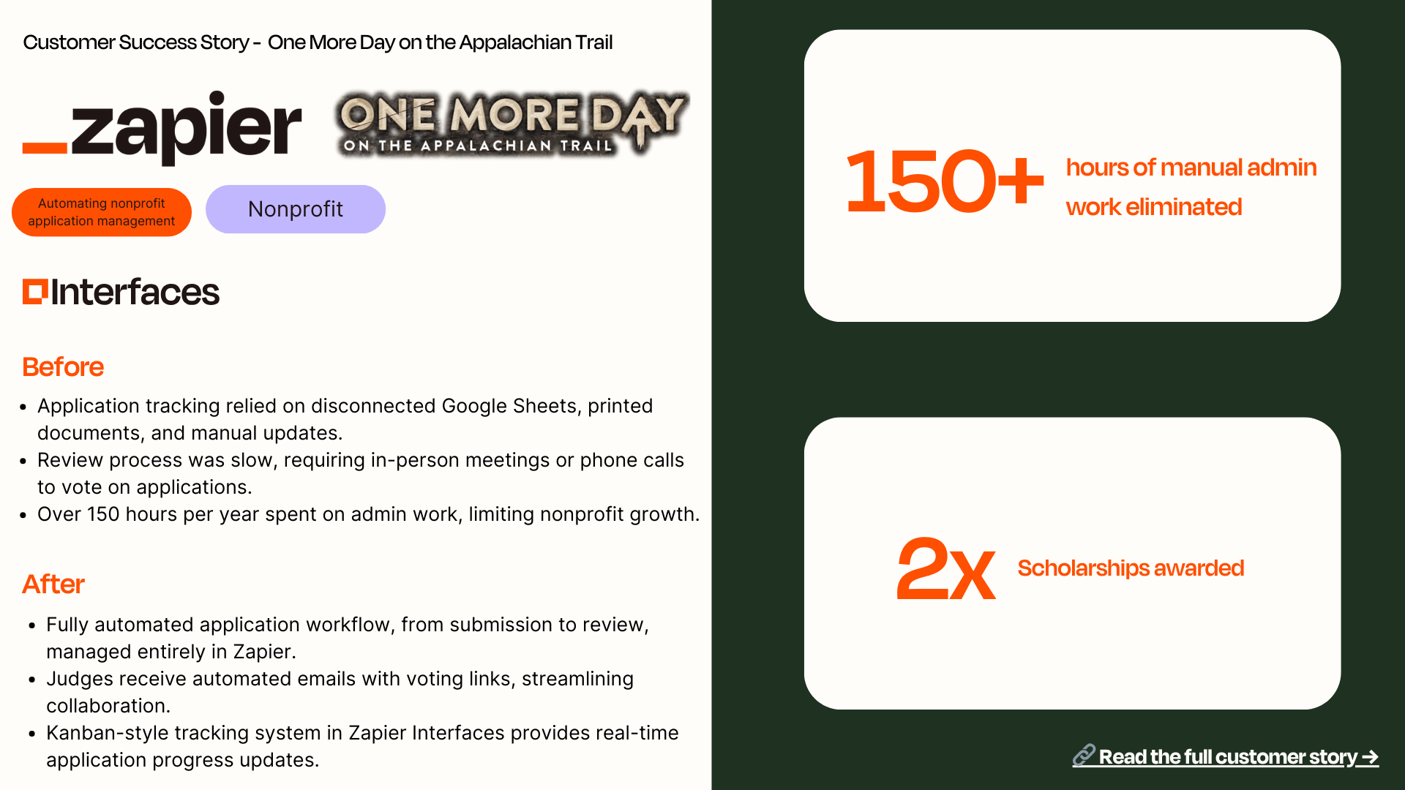

Slide 30


Slide 31
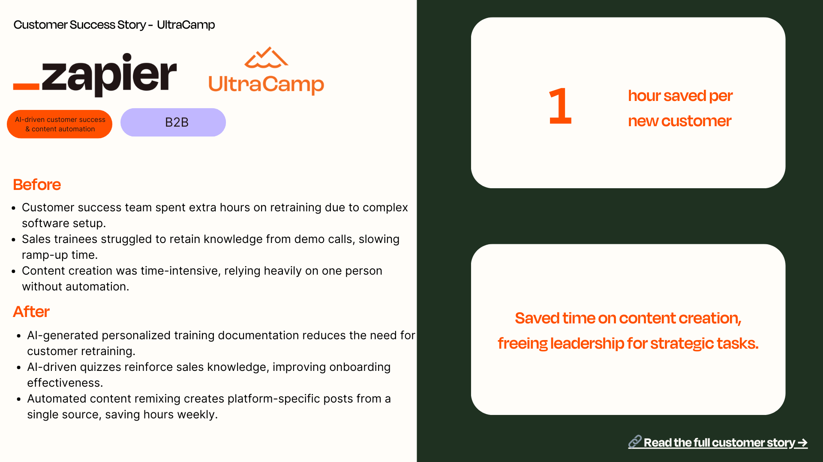

Slide 32
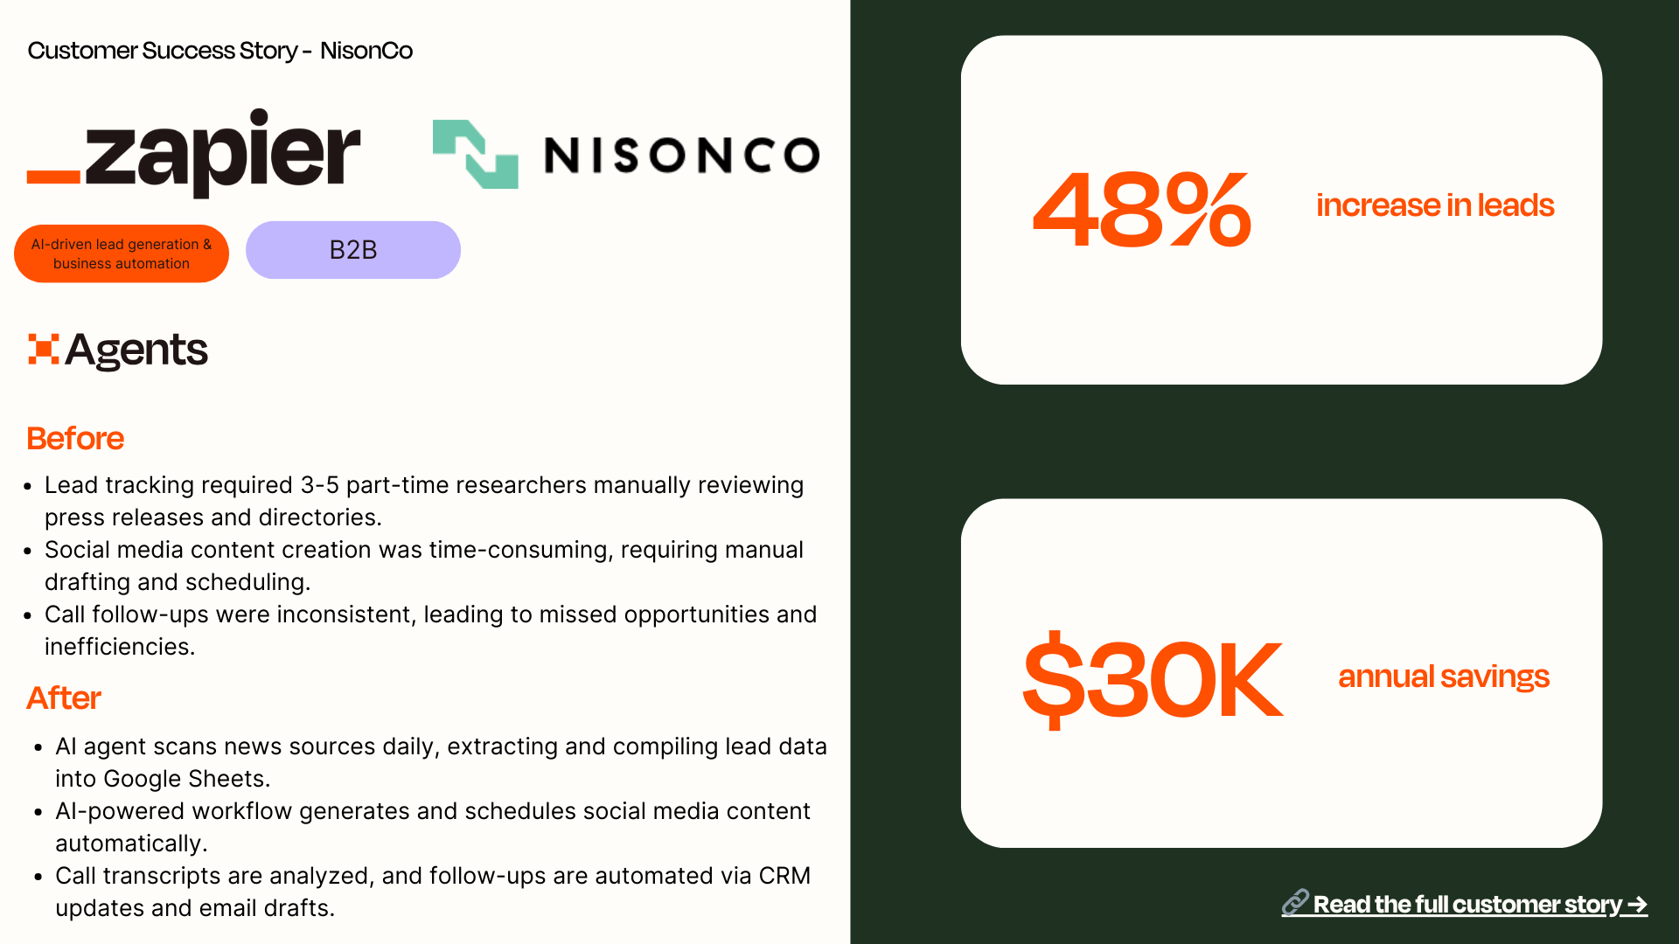

Slide 33
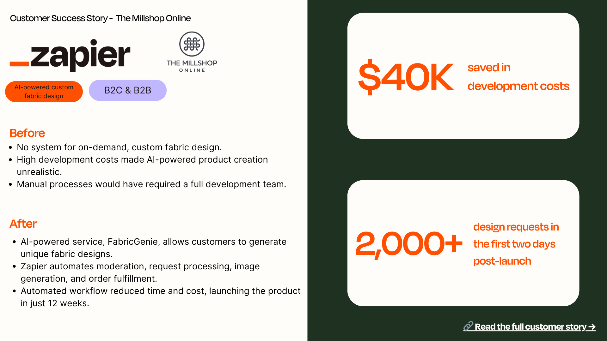

Slide 34
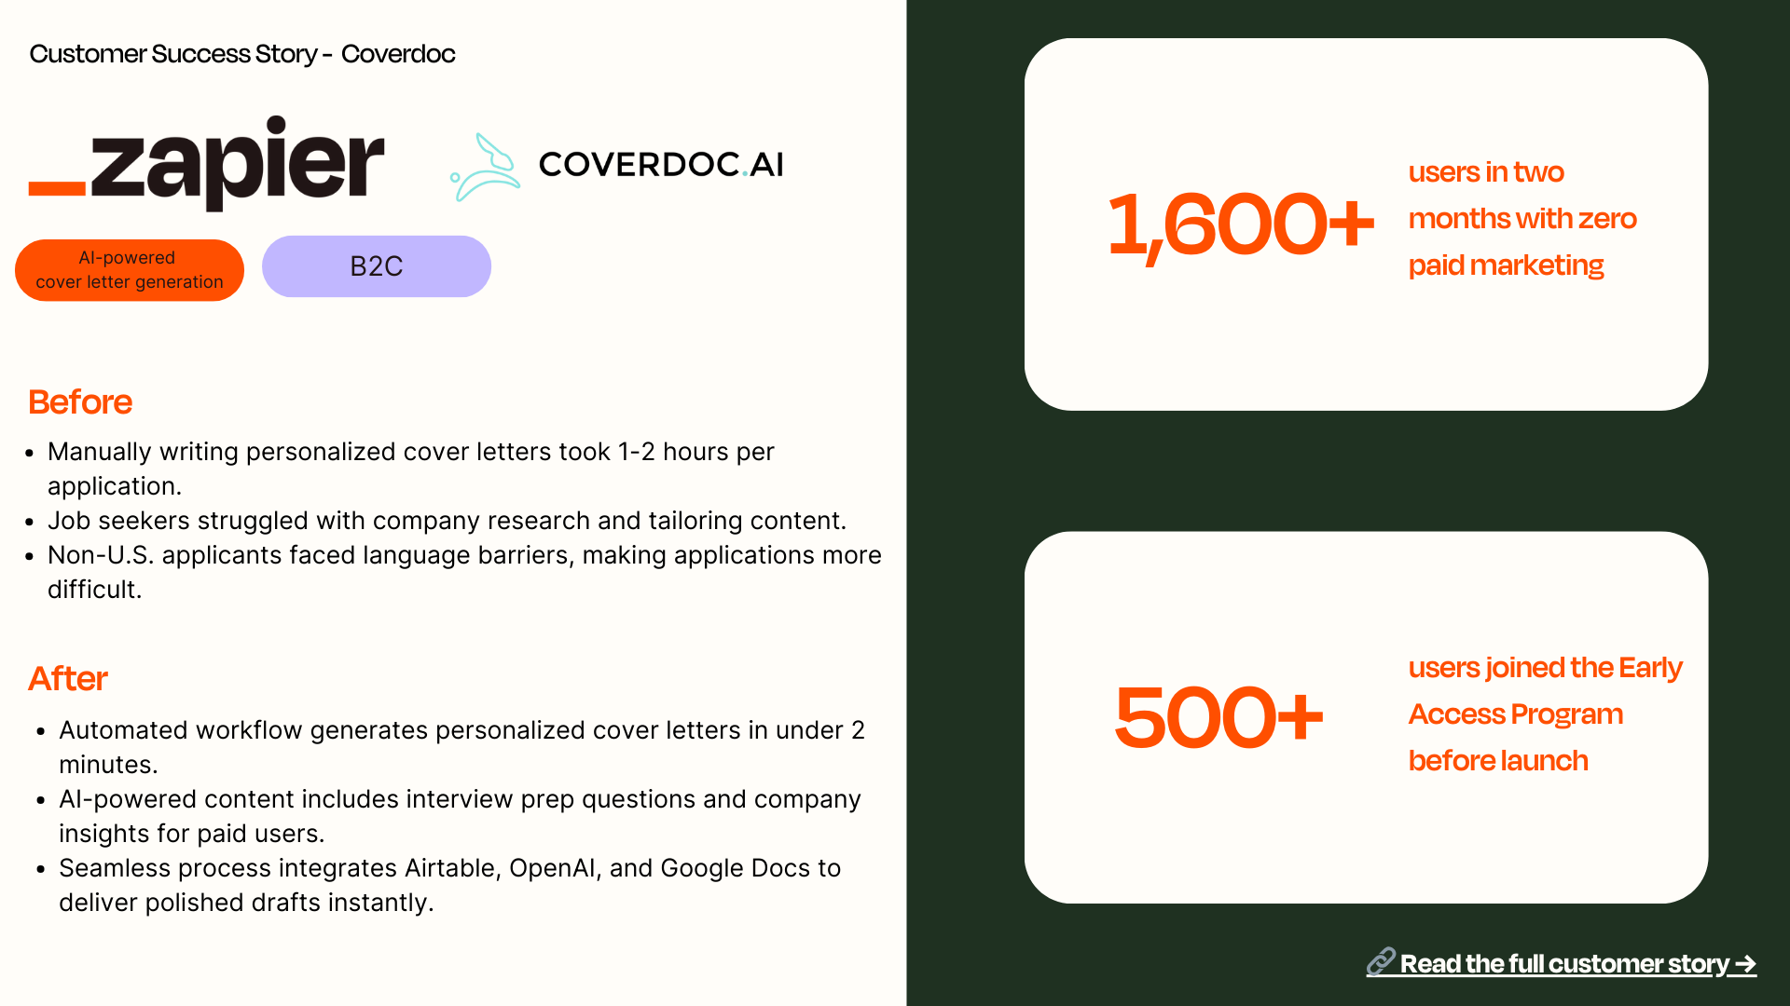

Slide 35
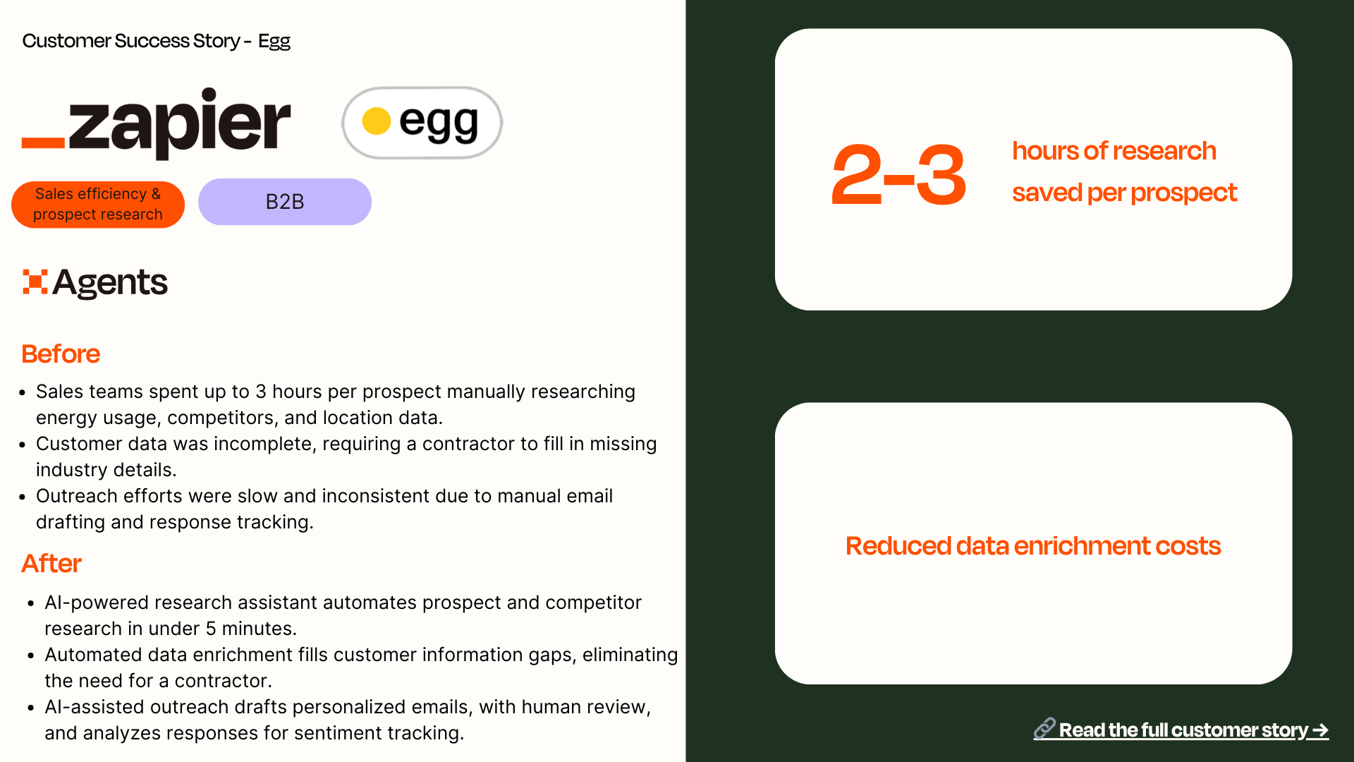

Slide 36
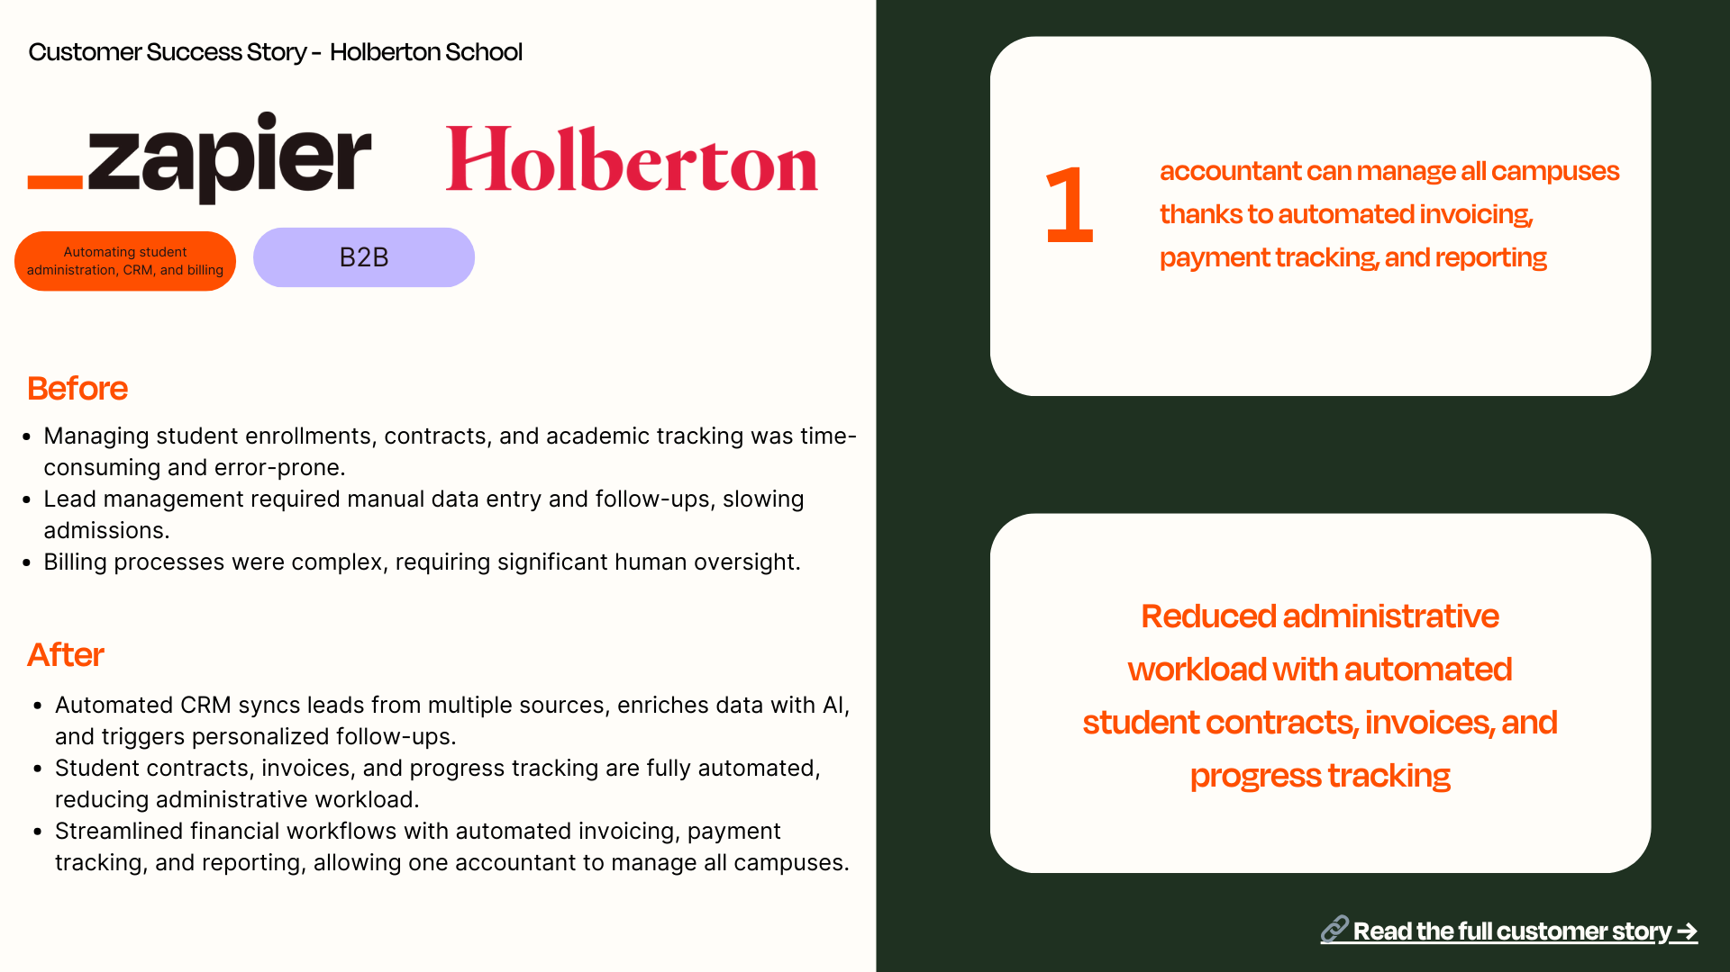

Slide 37
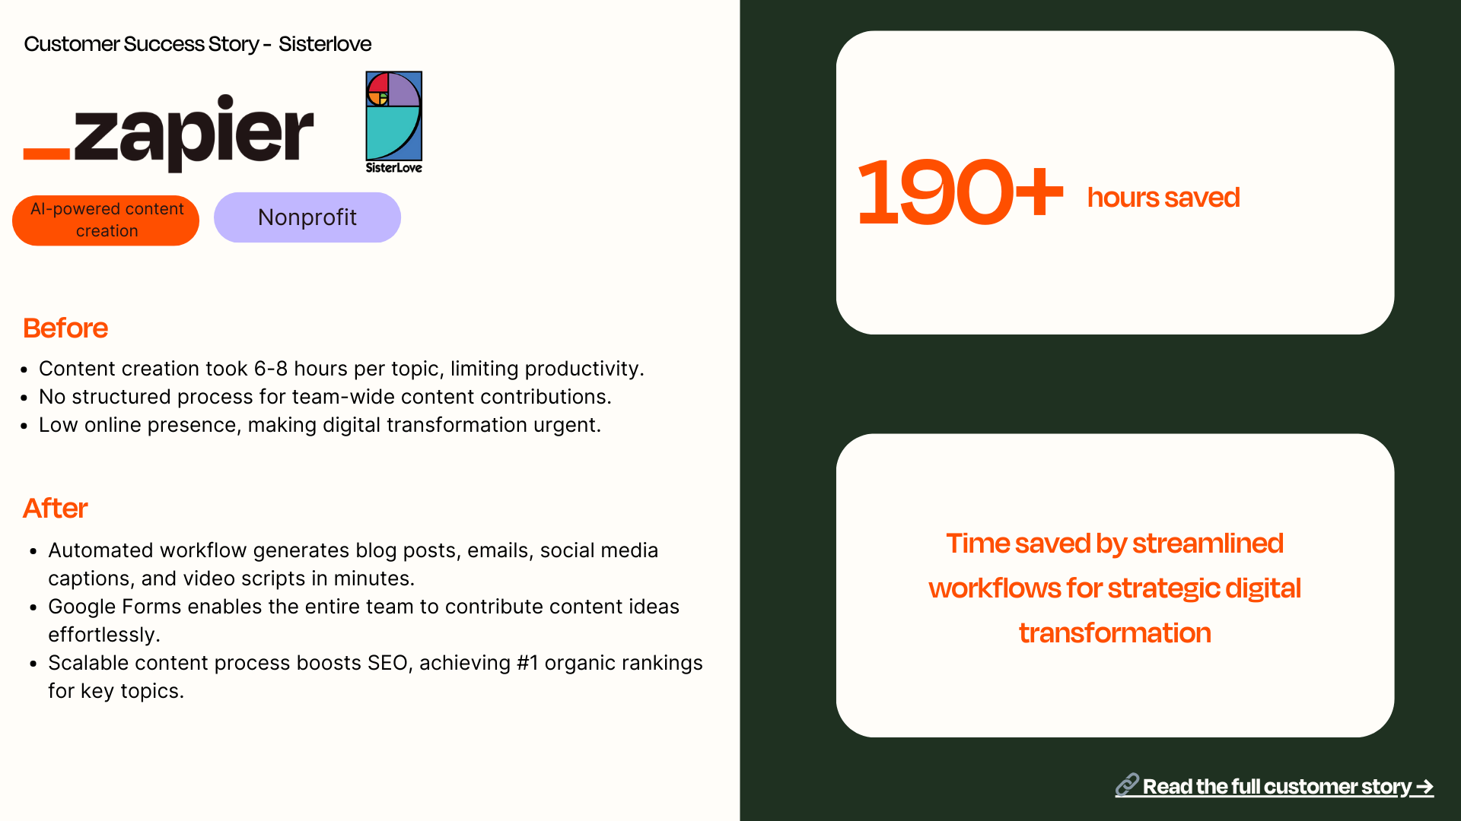

Slide 38
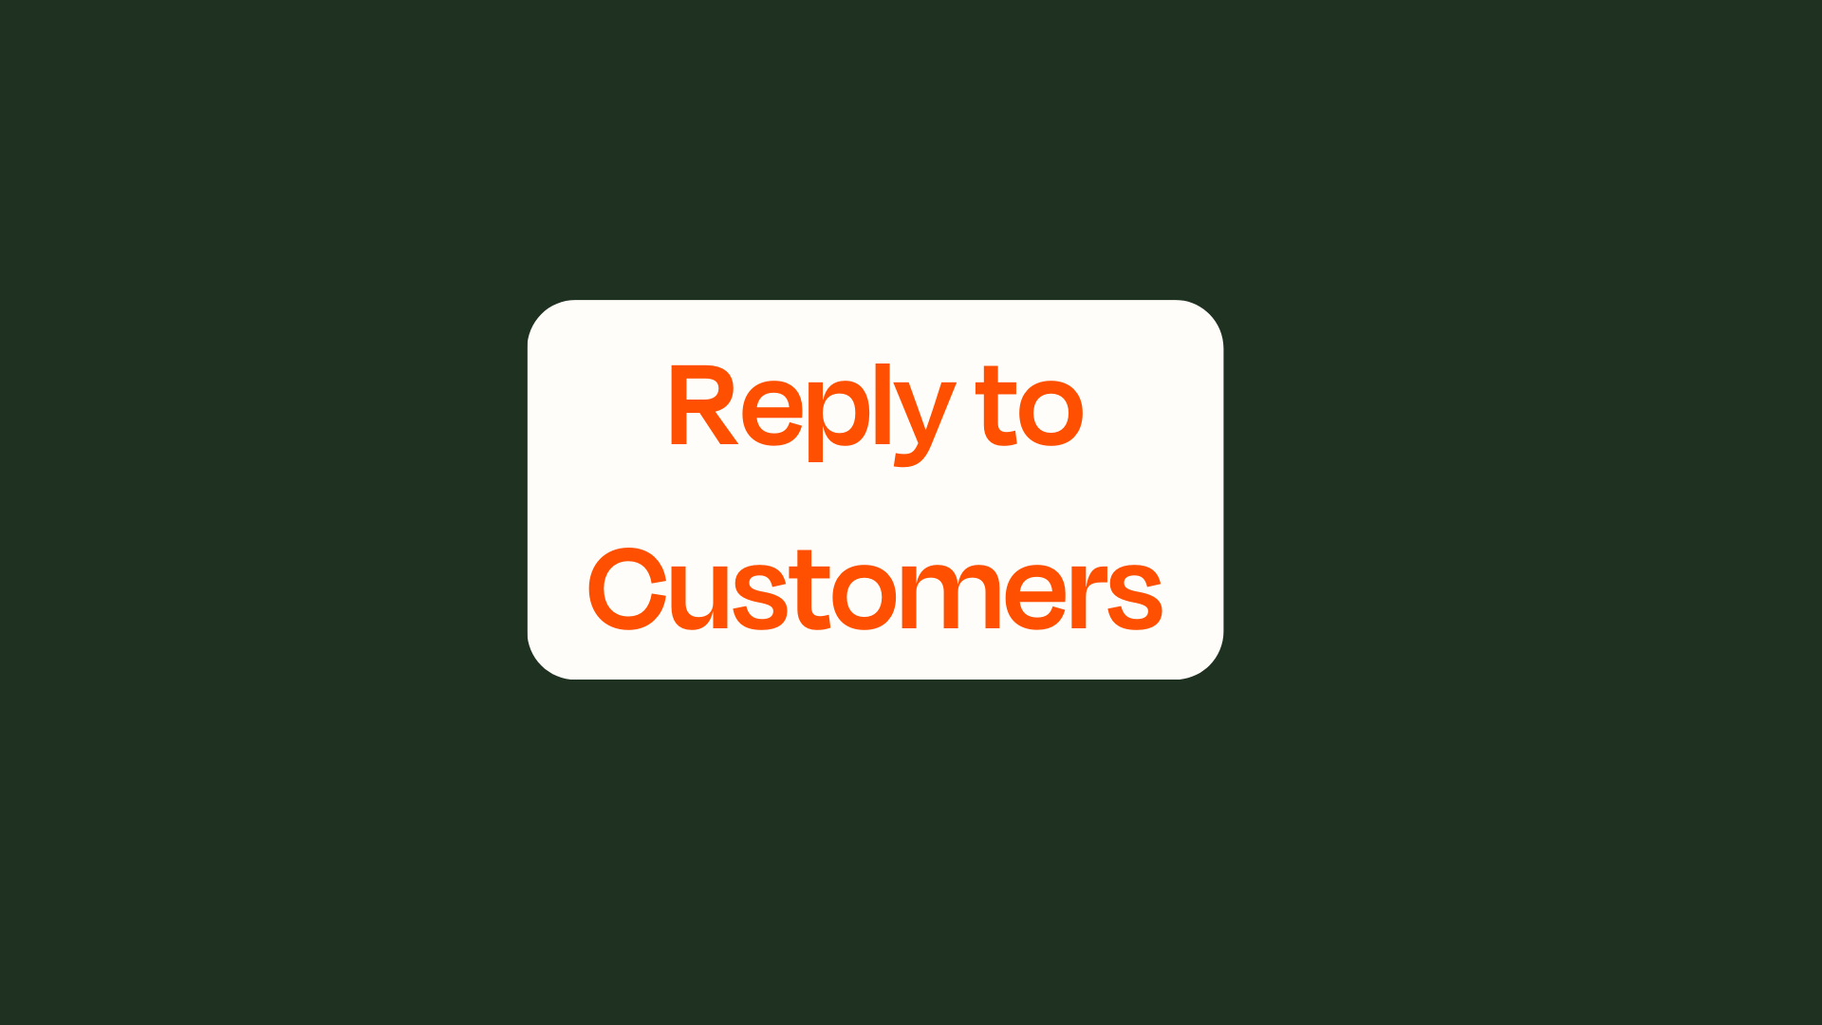

Slide 39
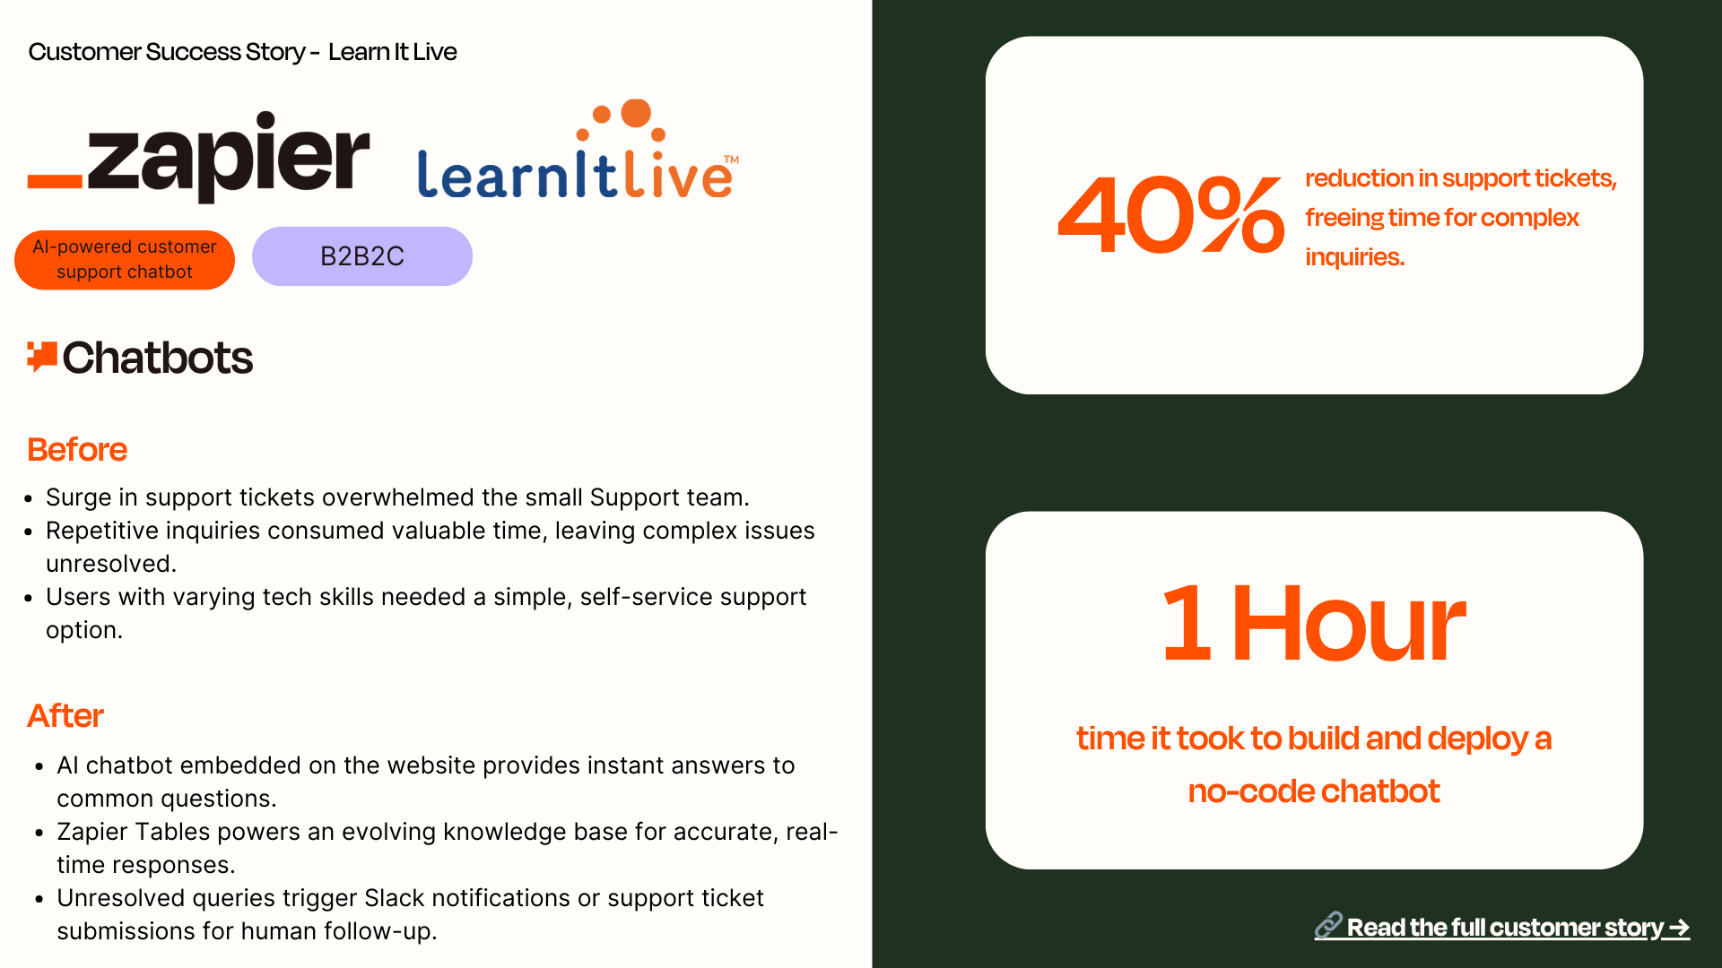

Slide 40
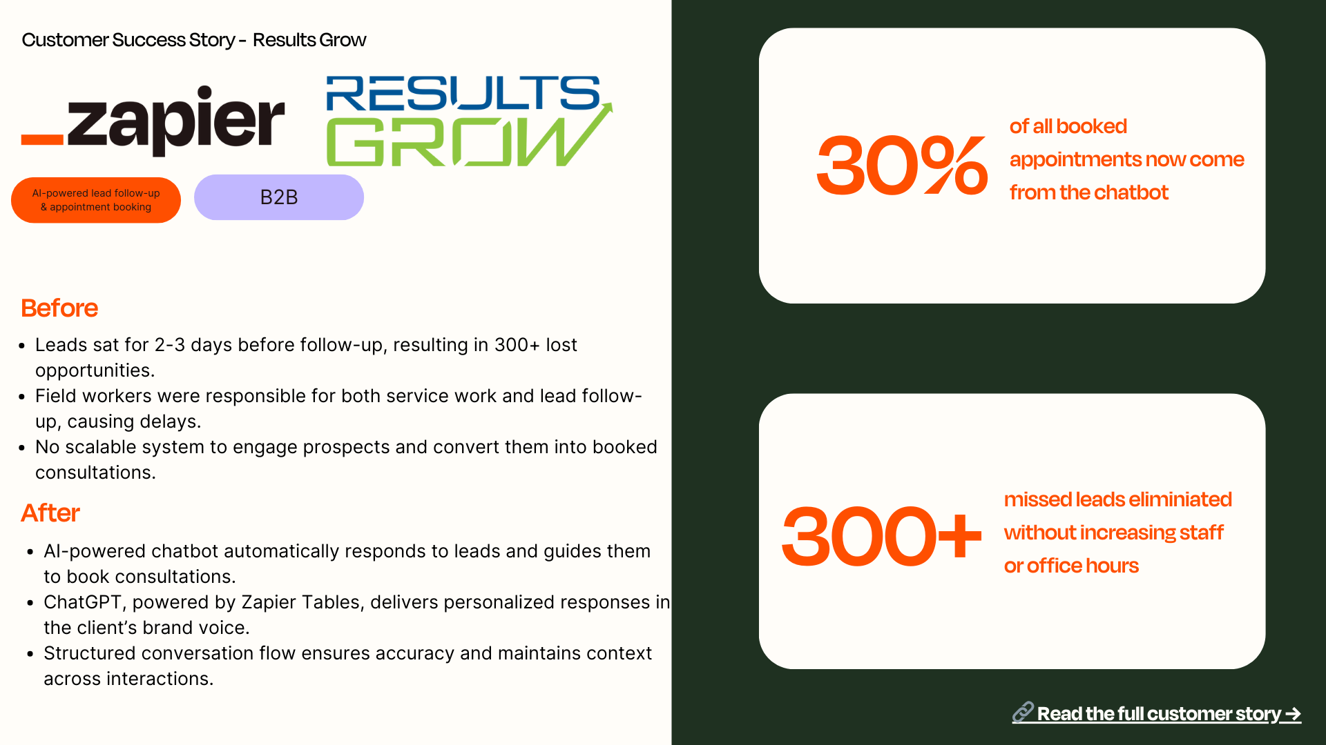

Slide 42
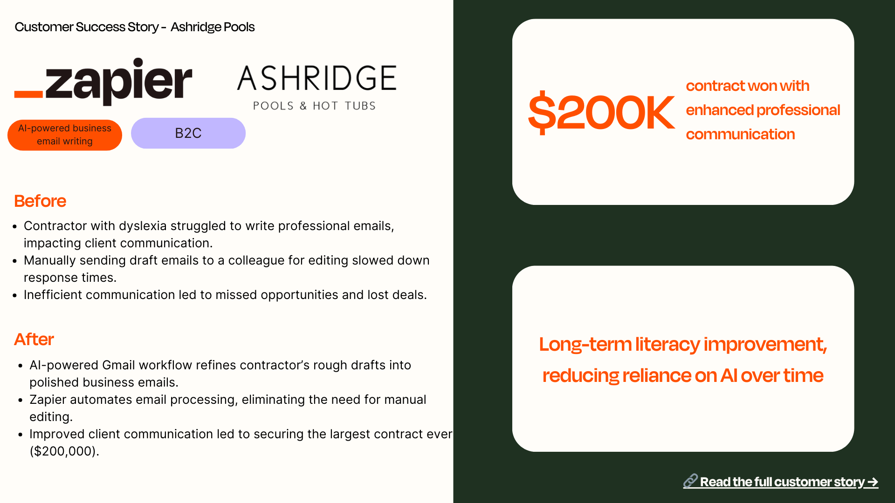

Slide 43
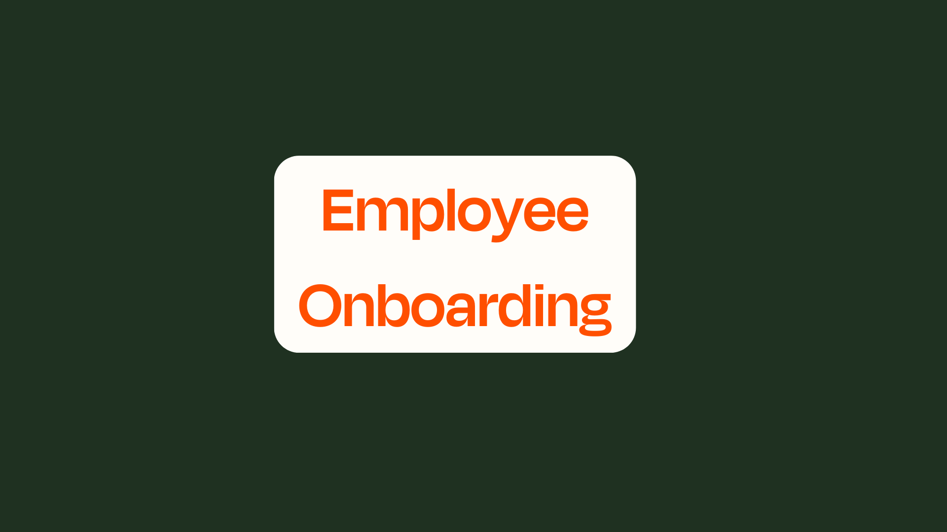

Slide 44
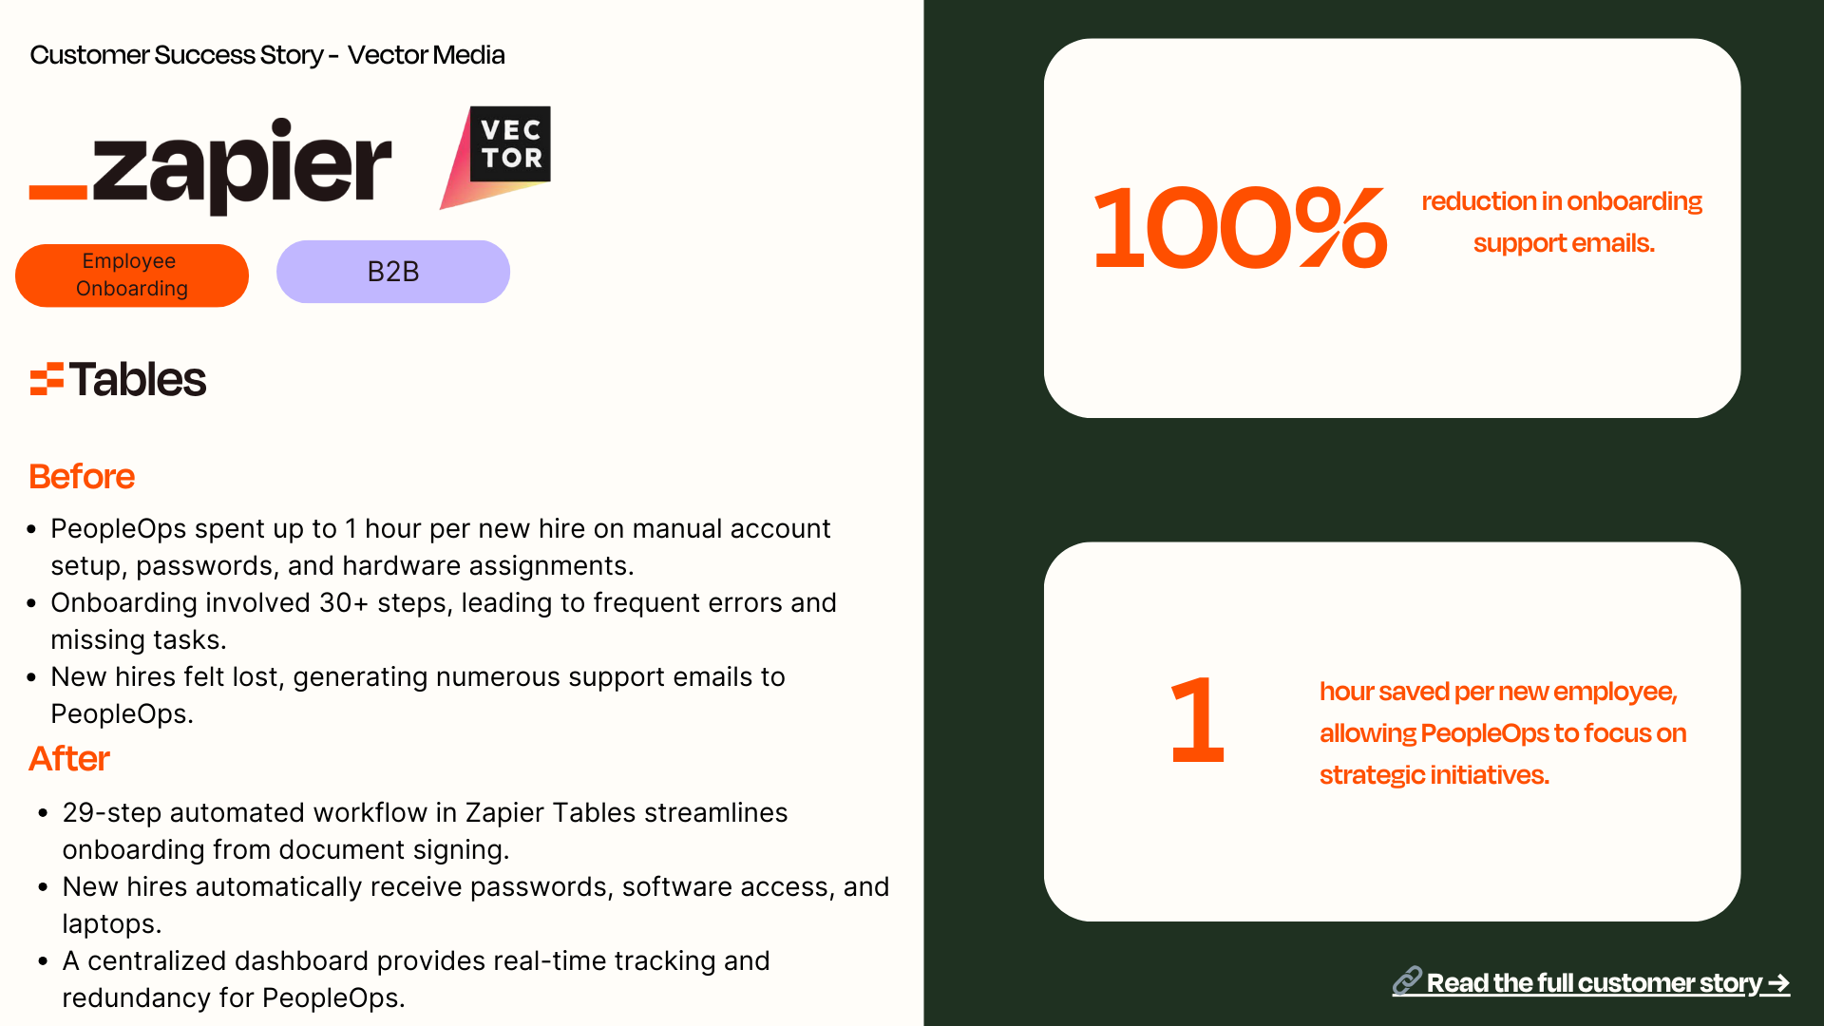

Slide 45
